Slide 1


Spatial examination of the critical minerals and existing mine operations in the US
Nurana Ismayilova

Slide 2
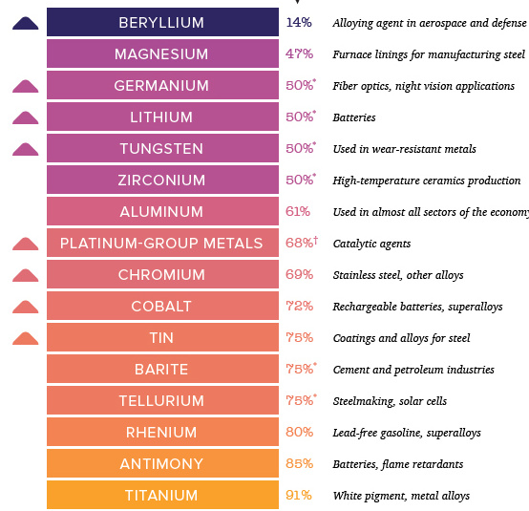
Introduction
GIS is useful in determining the potential mine sites and mineral resources
Using the spatial data, mine reclamation activities can be improved
Study focuses on the distribution of mineral resources and mine sites to determine potential new mine locations for mineral resources without mine plant within 20 km
https://www.visualcapitalist.com/35-minerals-critical-security-u-s/

Slide 3
Literature Review
Gorokhovich et al. (2003) Methodology:
Implemented GIS for identifying suitable mine sites.
Correlated abandoned mines with railroad data.
Fadda et al. (2010) Study:
Analyzed potential mine sites for reutilization.
Conducted topographic survey, GPS, and 3D analysis using GIS.
Integrated data layers into geological maps for easier site analysis.
Kim et al. (2012) ArcMine:
GIS extension for reclamation activities.
Utilizes spatial database to visualize mine hazards.
Incorporates mine maps, borehole data, geological, and topographical maps.
Examines mine subsidence, waste erosion, and suggests tree species for reclamation.
GIS Applications in Mine Recovery:
Provides soil quality statistics.
Tracks spatial changes using NDVI information.
Monitors surface hydrology, groundwater changes, and vegetation variation.

Slide 4
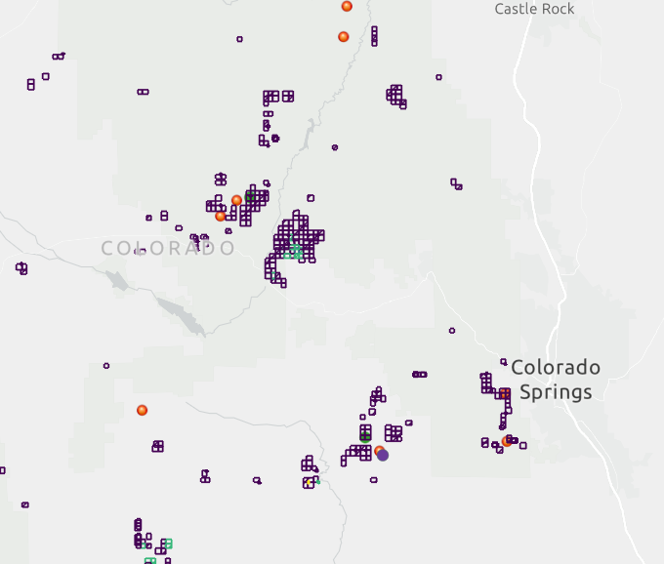
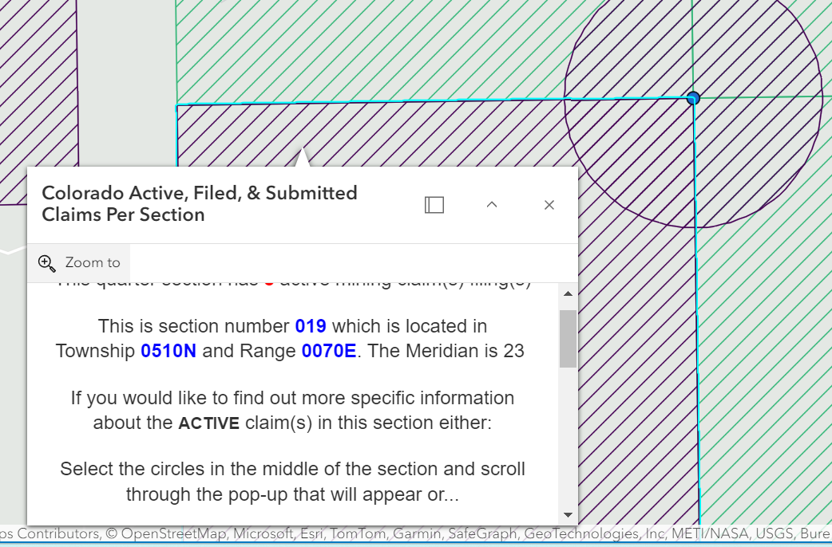
Datasets
Global Critical Mineral Locations Dataset:
Derived from an online feature layer.
Represents mineral locations globally as of 2017.
Includes point and polygon data of 22 mineral commodities crucial to the U.S. economy.
Original source: U.S. Geological Survey (USGS) from various centers.
US Mineral Mining Operations Dataset:
Excludes sand, gravel, stone, clay, and shale mines.
Data obtained from the National Minerals Information Center of USGS from 2003.
Contains mine names, mineral commodity types, and locations.
Colorado Mine Claims Dataset:
Represents mine claim types: placer, lode, mill, and tunnel.
Produced by the Nevada Division of Minerals.
Includes the number of claims and operating companies.

Slide 5
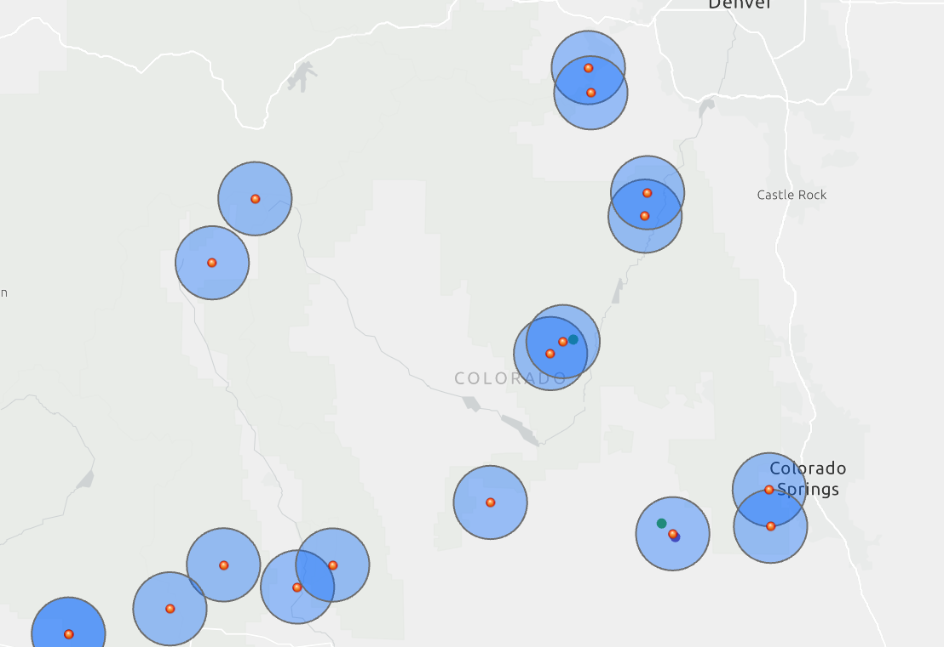
Methods
Study Methods:
Utilized spatial density analysis (kernel density mapping), buffer analysis, local statistical analysis, and geovisualization.
Data Processing:
Global mineral locations dataset was clipped to the U.S. region using the "Clip" tool to create a new layer.
Kernel Density Map plotted for both mineral and mining locations.
Buffer Analysis:
Created around mineral locations and mine sites to identify optimal mineral sources without nearby mine plants within 20 km.
Focus on Colorado State:
Examination conducted specifically for Colorado due to available mine claims data.
Data Visualization:
Pie charts created to understand the distribution of critical minerals and states with the most mining activities.

Slide 6
Results
NNI and Moran's I Results:
NNI (Nearest Neighbor Index) indicates clustered distribution with p~0.00001 and z=-28.67.
Moran’s I results for mineral distribution show z score of 33.3 and p~0.000001, confirming positive spatial autocorrelation
Buffer Analysis:
Buffers created around minerals and mine sites to identify mineral locations without nearby mine activity within a 20 km distance.
Colorado Analysis:
Same methodology applied using mine claim dataset.
Identified potential critical minerals for mining: Titanium, Rhenium, Vanadium, Niobium, and Tantalum.
Data Visualization:
Pie charts generated by ArcGIS "Charts" section depict distribution of critical minerals and mine sites across the U.S.A.

Slide 7
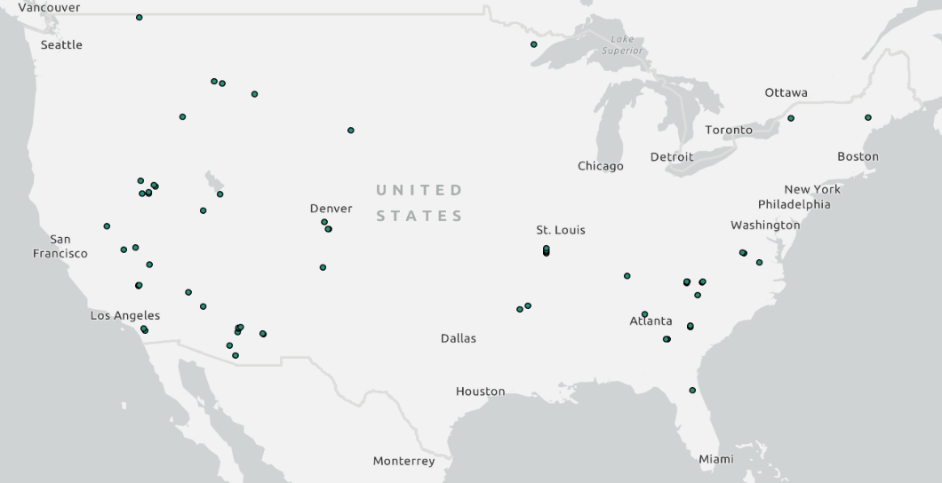
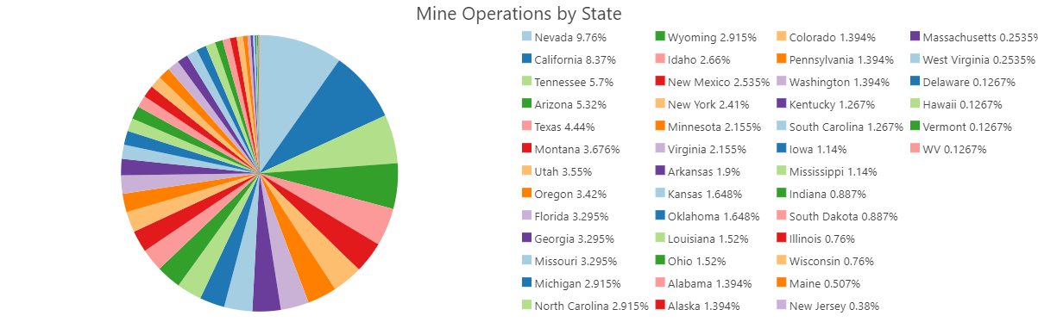
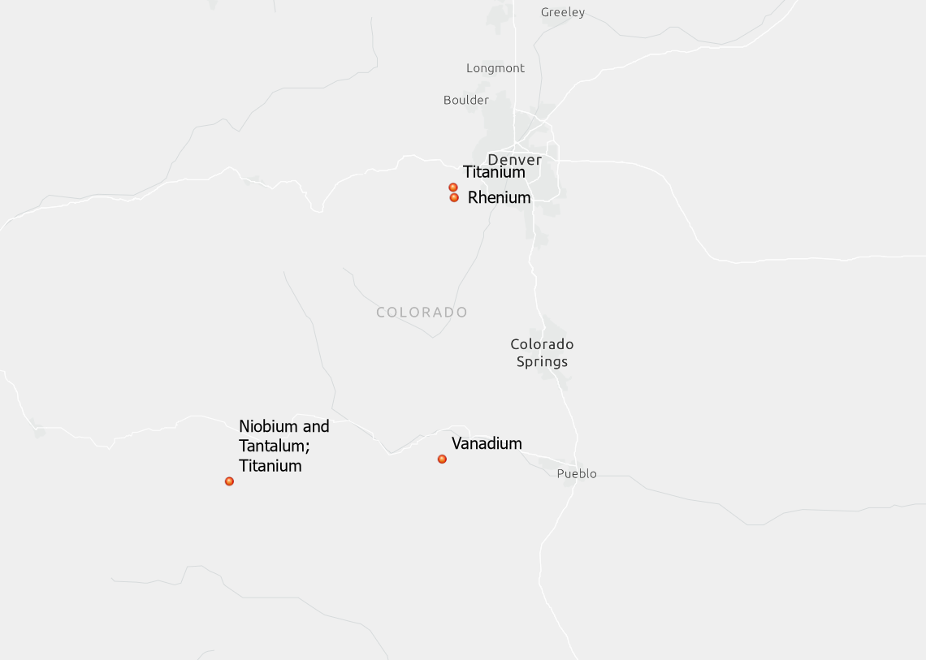
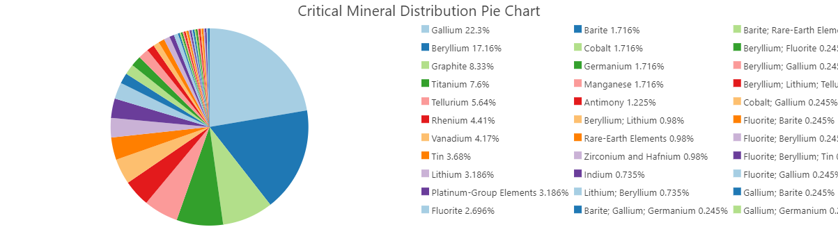

Slide 8
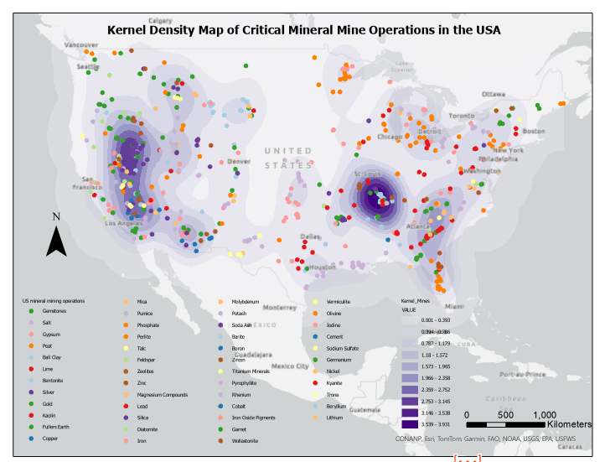
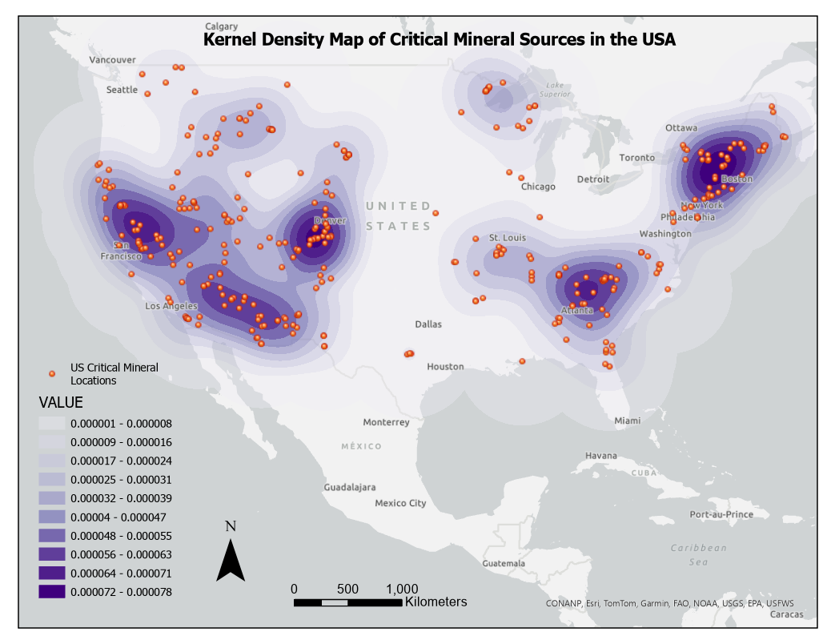
Figure 4. a) KDE map critical mine operations in US b) KDE map of critical mineral source locations in US

Slide 9
Conclusion
Comprehensive GIS analysis conducted on global mineral locations and U.S. mining operations.
NNI and Moran's I statistical analyses confirm clustered distribution of critical minerals.
Buffer analysis identifies optimal mineral sources without nearby mine activity within 20 km radius.
Colorado analysis using mine claim data identifies Titanium, Rhenium, Vanadium, Niobium, and Tantalum as potential critical minerals for mining.
Pie charts visually represent distribution of critical minerals and mining activities across the U.S.A.
Findings provide valuable insights for policymakers and stakeholders to optimize resource utilization and promote sustainable mining practices.

Slide 10
References
Gorokhovich, Y.; Voros, A.; Reid, M.; Mignone, E. Prioritizing Abandoned Coal Mine Reclamation Projects Within the Contiguous United States Using Geographic Information System Extrapolation. Environ. Manage. 2003, 32, 527–534
Fadda, S.; Fiori, M.; Matzuzzi, C. Developing rehabilitation design for the abandoned mine excavations in central Sardinia, Italy. Int. J. Min., Reclam. Environ. 2010, 24, 286–306
Kim, S.M.; Choi, Y.; Suh, J.; Oh, S.; Park, H.D.; Yoon, S.H.; Go, W.R. ArcMine: A GIS extension to support mine reclamation planning. Comput. Geosci. 2012, 46, 84–95.
Wang, J., Yang, R., & Feng, Y. (2017). Spatial variability of reconstructed soil properties and the optimization of sampling number for reclaimed land monitoring in an opencast coal mine. Arabian Journal of Geosciences, 10(2), 1–13.
Global Critical Mineral Locations dataset: https://www.arcgis.com/home/item.html?id=cafdc13445b74f7f859d5aa178d14668
US Mineral Mining Operations: https://www.arcgis.com/home/item.html?id=89d0320c360a4b27b9421ad832d1be6b

